Slide 1
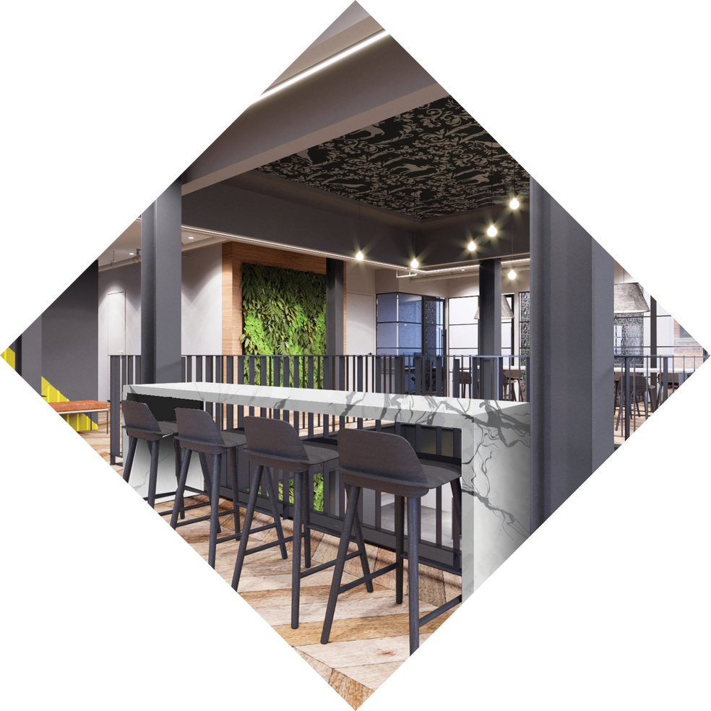
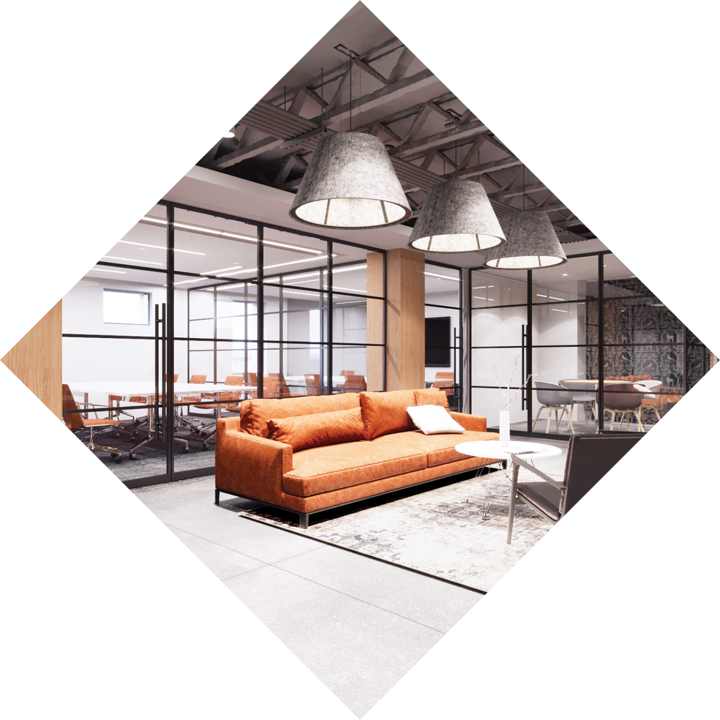


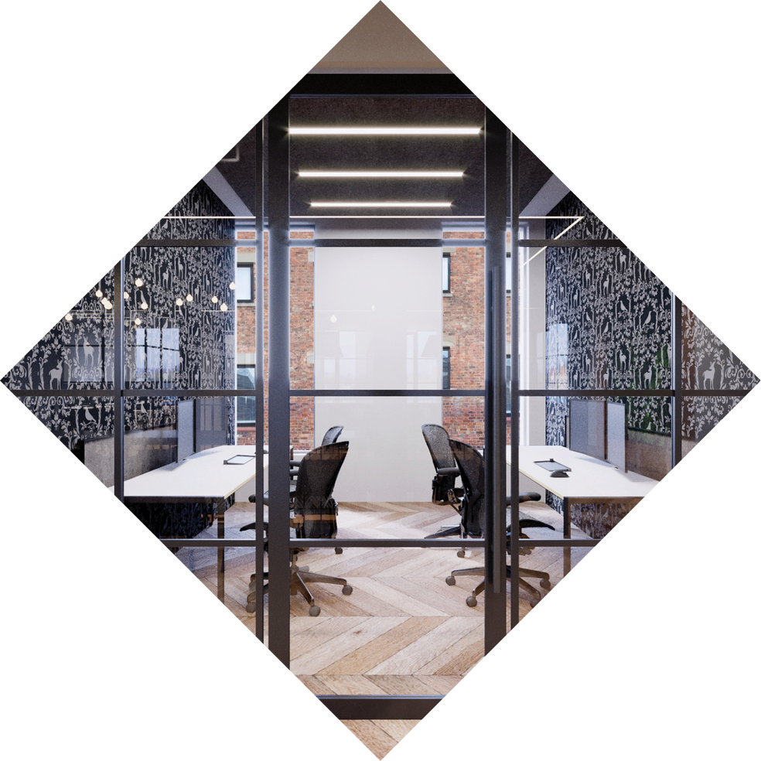
Venture X | San Diego – Scripps ranch
Microsoft Proposal

Slide 2


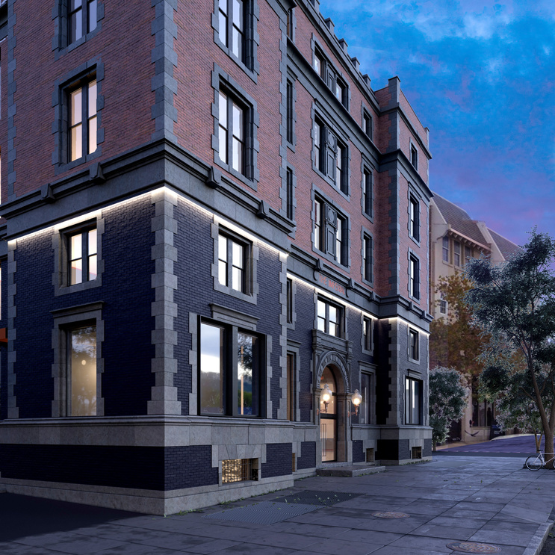
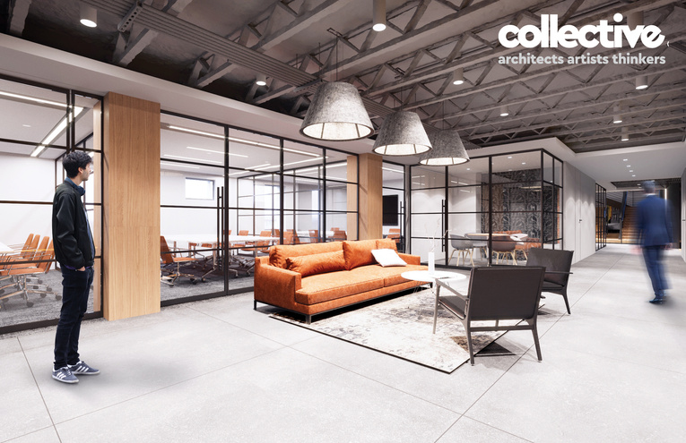
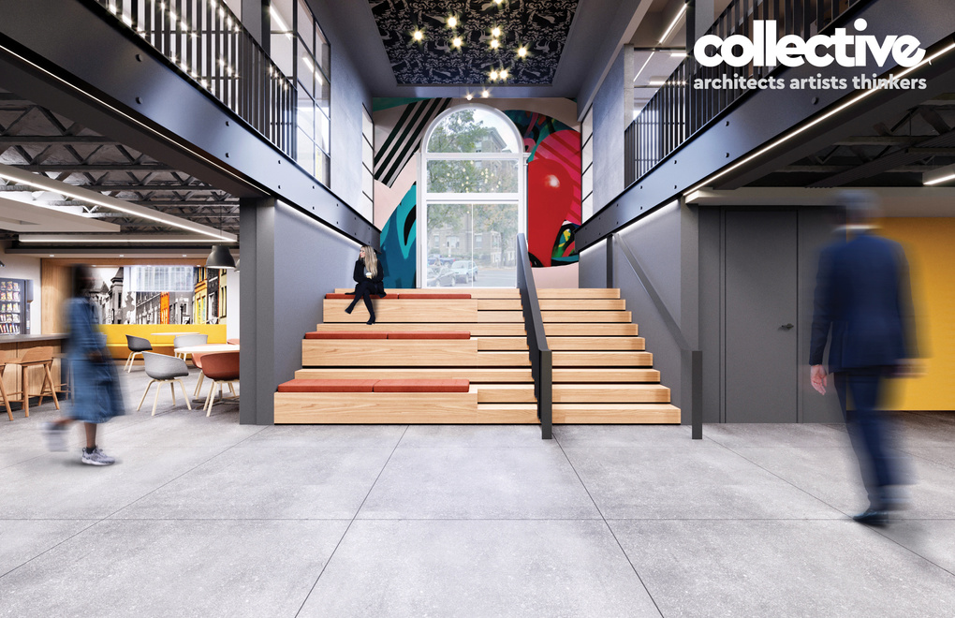
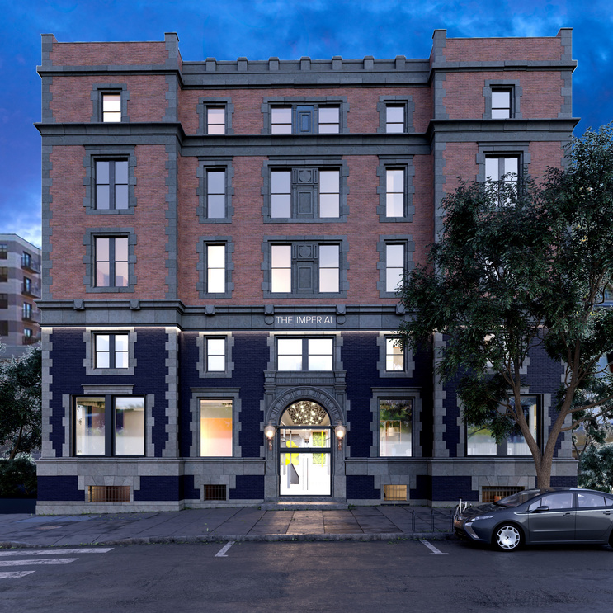
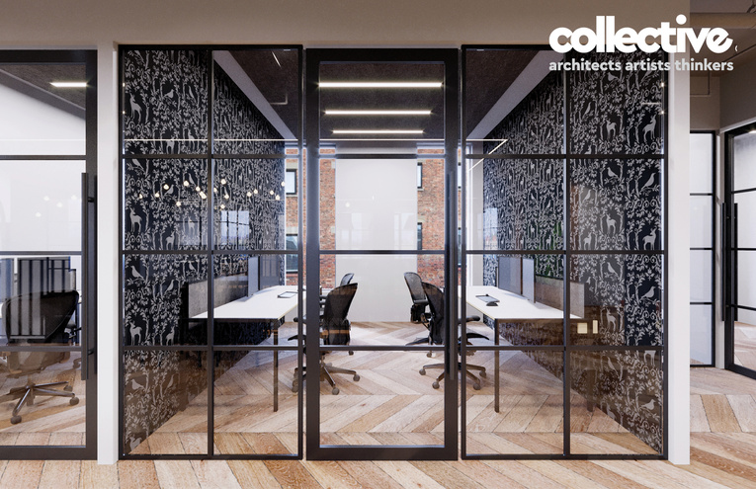
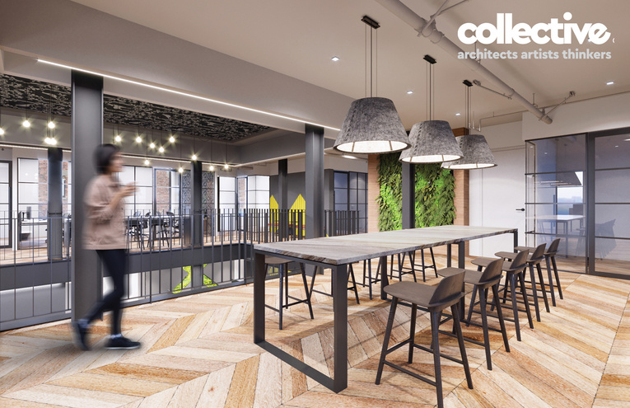
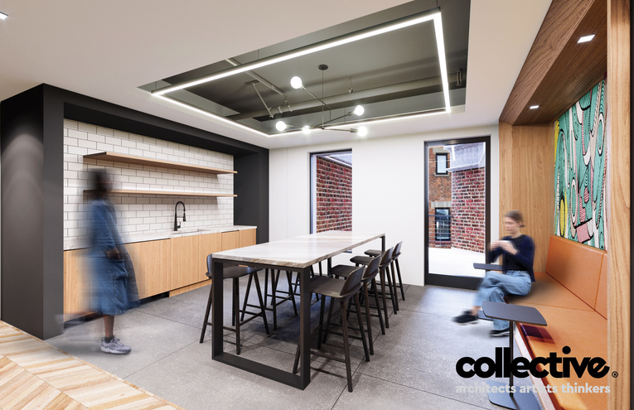
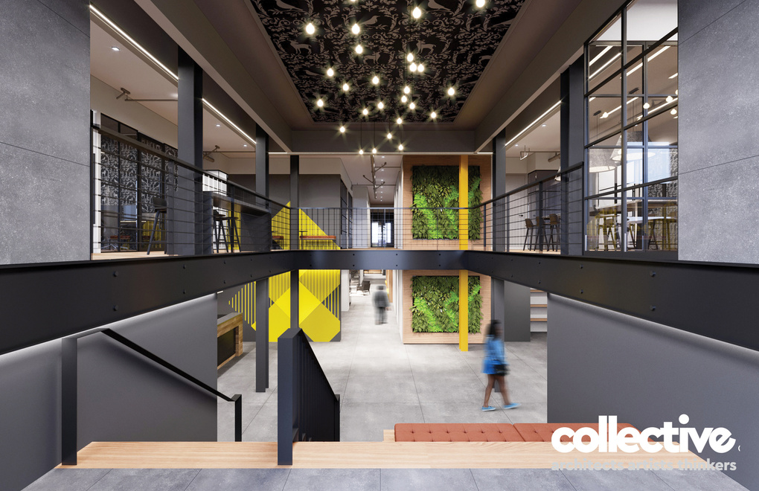
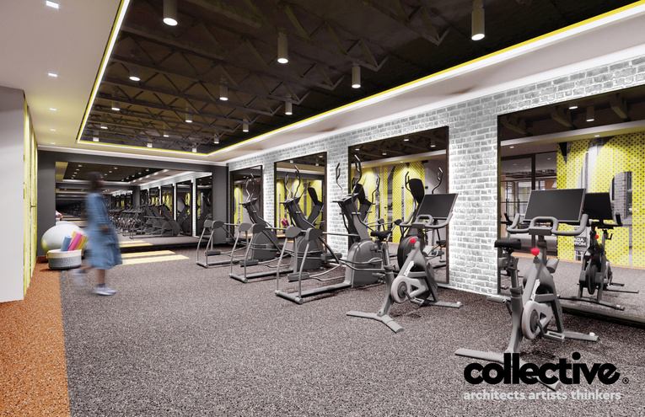
DETAILS
31,038 SQ. FT
70 PRIVATE OFFICES
34 DEDICATED DESKS
10 SHARED DESKS
314 TOTAL SEATS
EXECUTIVE BOARD ROOM
5 MEETING ROOMS
TRAINING ROOM
PHONE ROOMS
STREET LEVEL ACCESS
FULLY STOCKED CAFE
EVENT SPACE FOR 50-75
PRIVATE WELLNESS ROOM
FITNESS STUDIO WITH PRIVATE SHOWERS
SECOND FLOOR PANTRY
3 EXTERIOR DECKS
BIKE ROOM
KEYLESS ACCESS CONTROL

Slide 3
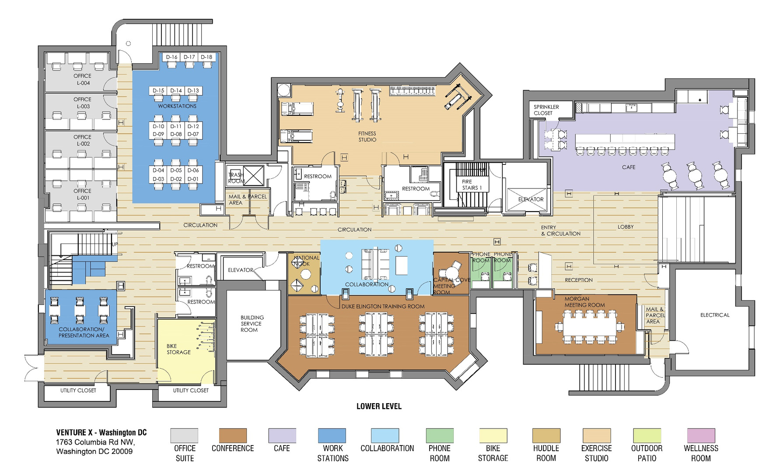

LowER LEVEL
10,378 SQ. FT
4 PRIVATE OFFICES
18 DEDICATED DESKS
33 TOTAL SEATS
1 EXECUTIVE BOARD ROOM
2 MEETING ROOMS
TRAINING ROOM
PHONE ROOMS
EVENT SPACE FOR 50-75
FULLY STOCKED CAFÉ
FITNESS STUDIO WITH PRIVATE SHOWERS
BIKE ROOM
COLLABORATION AREA
MAIL & PARCEL AREA

Slide 4
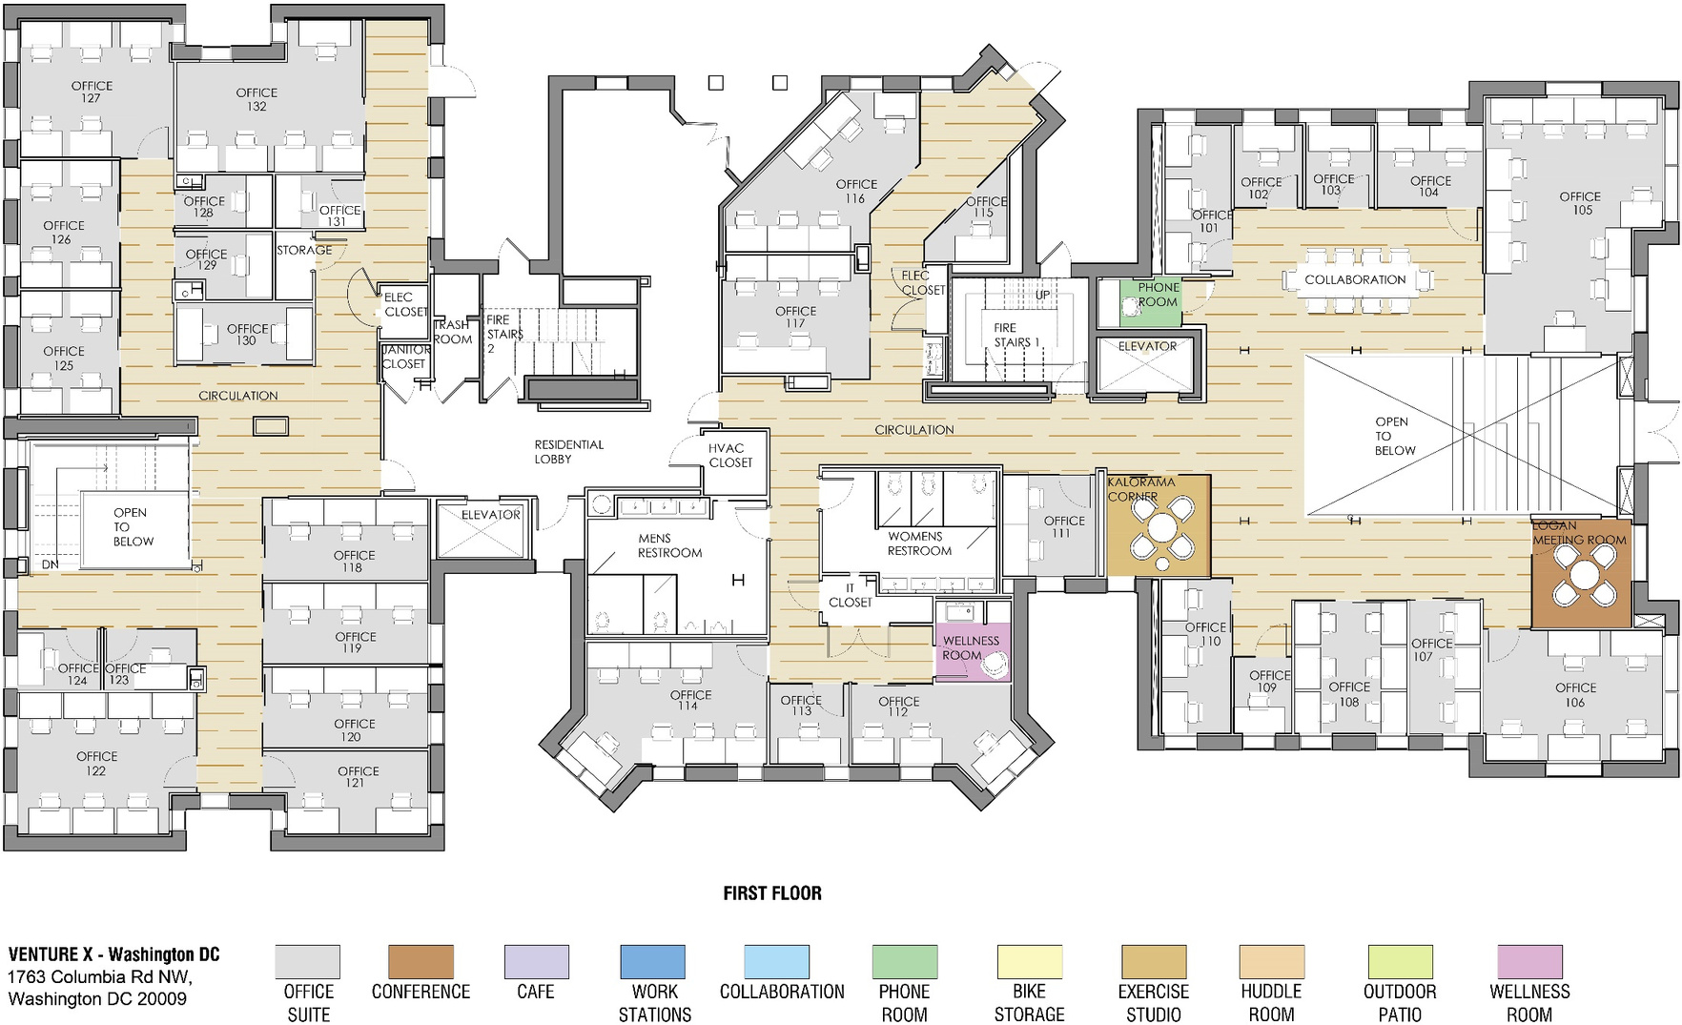
FIRST FLOOR
10,282 SQ. FT
32 PRIVATE OFFICES
10 SHARED DESKS
107 TOTAL SEATS
2 MEETING ROOMS
PHONE ROOM
STREET LEVEL ACCESS
PRIVATE WELLNESS ROOM
ATRIUM VIEW

Slide 5
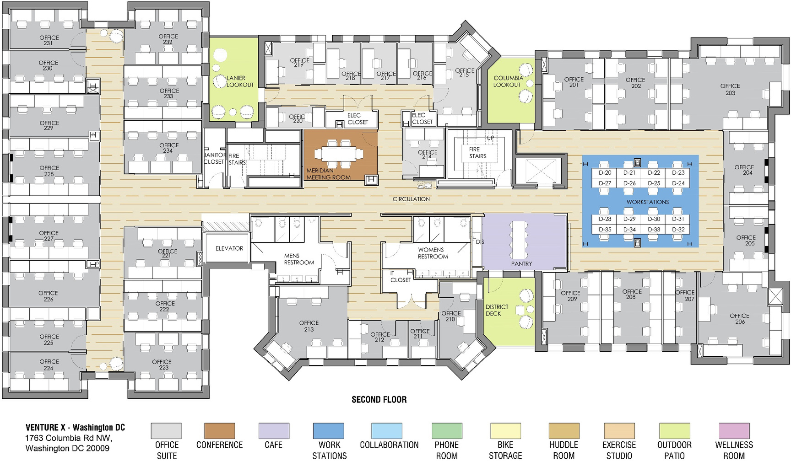
SECOND FLOOR
10,378 SQ. FT
33 PRIVATE OFFICES
16 DEDICATED DESKS
171 TOTAL SEATS
MEETING ROOM
PANTRY
3 DECKS WITH EXTERIOR MEETING SPACE, CAFÉ SEATING, AND LOUNGE

Slide 6

Quote for XYZ Company
Quote for XYZ Company
Option 1:
Price
(per Month)
Per Person price (per Month)
Space
Description
Term
Space
Description
Term
Price
Price
Option 2:
Price
(per Month)
Per Person price (per Month)
Space
Description
Term
Space
Description
Term
Price
Price
Additional discounts available:
10% for 6-month term OR
15% for 12-Month Term

Slide 7
Quote for XYZ Company
Quote for XYZ Company
Standard Pricing:
Price
(per Month)
Per Person price (per Month)
Space
Description
Term
Space
Description
Term
Price
Price
Term
Price
Price
XYZ Company Proposal
Savings
$$$
$$$
Additional discounts available:
10% for 6-month term OR 15% for 12-Month Term

Slide 8
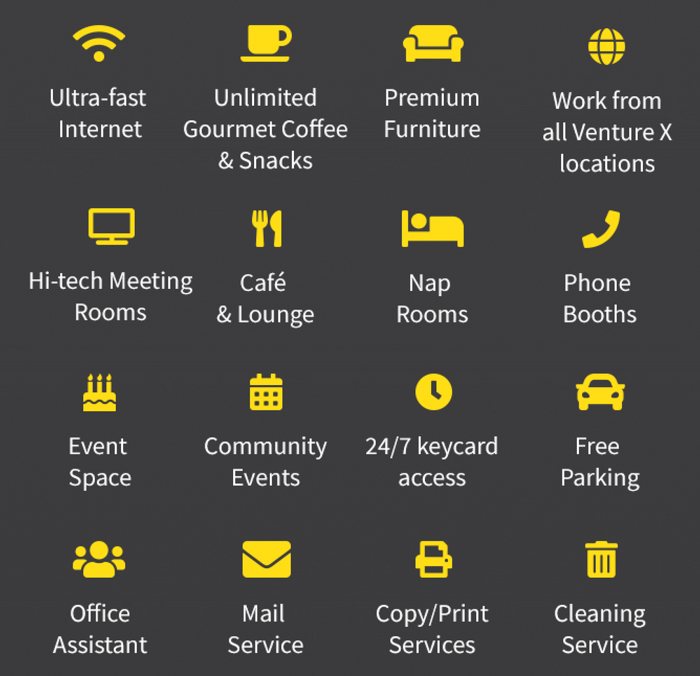

Concierge Service and Premium Amenities
Private Offices with Furnishing by Humanscale. Each office includes ergonomic desk chair(s) and Sit/stand desks that allow users to change postures throughout the workday effortlessly while promoting a healthy and balanced level of activity in the workplace.
Conference Rooms w/video and phone conferencing
Best-in-class fiber internet
Wellness Room specifically designed for new working mothers (or other private health needs)
Fitness Studio with private showers
24/7 access
Month-to-month lease options
All utilities included
Keyless access control
Day-to-day office support
Reception greeting
Mail and package handling
Business printer/copier
Shredding services
IT support
Office Supplies
Cleaning service
Work from all Venture X locations around the world
Business and networking events
Professional community for business support
Discounts with business partners
Event space and planning
Unlimited locally roasted coffee and sparkling flavored water
Food market
Business Support
Community Support
Wellness
Room
The Space

